Slide 1
„World Heritage Day in Germany“
Kerstin Manz, German Commission for UNESCO, and
Claudia Schwarz, Association of German World Heritage Sites
Second Meeting of European World Heritage Associations
20-21 October 2016, Segovia, Spain

Slide 2
Aim:
To raise public awareness of German World Heritage Sites and
the objectives of World Heritage and UNESCO
Initiators:
German Commission for UNESCO and Association of German World Heritage Sites

Slide 3
History:
Set-up:
Launch in 2005
Each year on first Sunday in June
All World Heritage sites join the celebrations
One central event organised by one World Heritage site
Yearly changing mottoes 2005 – 2014

Slide 4
Mottoes:
Living World Heritage
Discovering World Heritage
„We have inherited“
„Looking for roots“
Conservation and development
…without borders
World Heritage unites
now our permanent motto

Slide 5
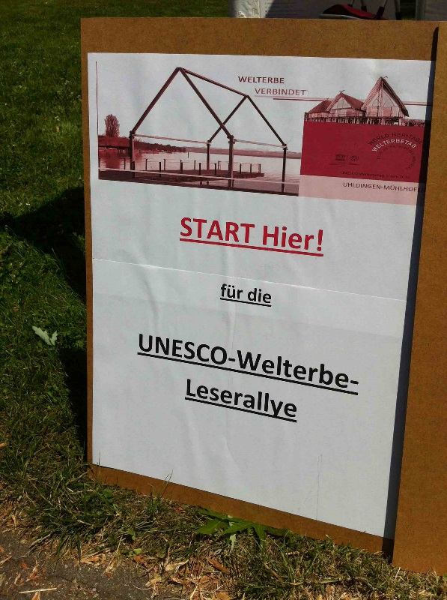
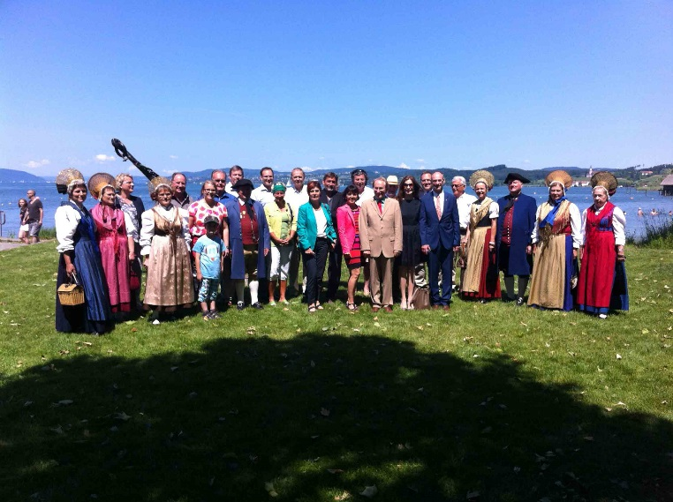
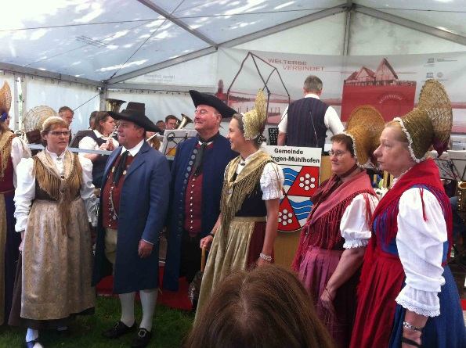
World Heritage Day 2015 Central Event
Unteruhldingen
Prehistoric Pile dwellings around the Alps

Slide 6
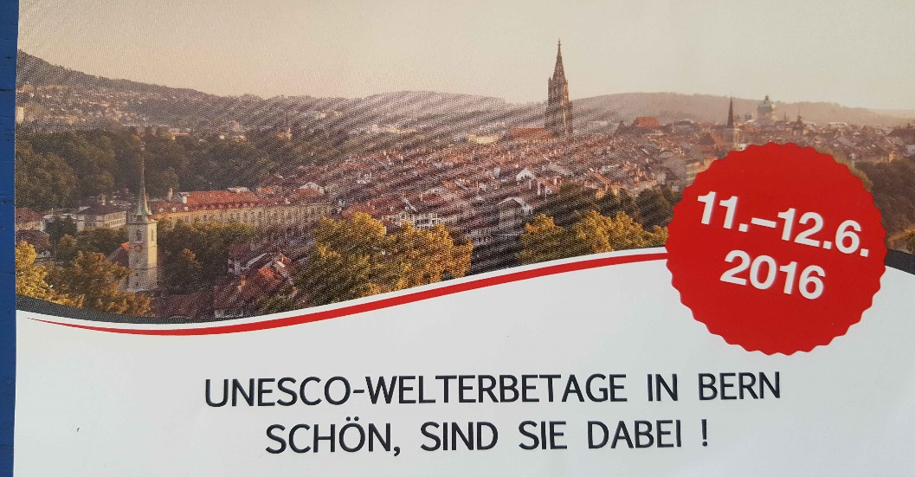
Results:
10 years of experience
June 2016: first bilateral German-Swiss Heritage Day in Bern

Slide 7
Results / Evaluation:
Opportunity to present objectives and activities of UNESCO and World Heritage to a wide public
Forum for communicating with and among local communities
Increasing identification with sites: „ I am World Heritage“
Opportunity for intercultural dialogue

Slide 8
Impressions: Regensburg 2015

Slide 9
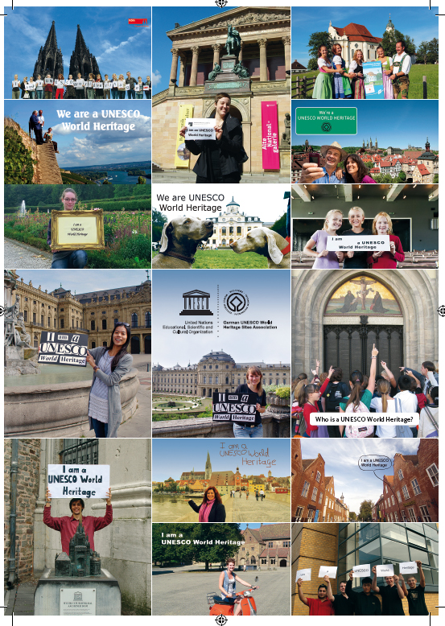
Our Proposal:
Towards a
European World Heritage Day
Your Opinion ……

